Slide 1
Employee Management System
Presented by:
Vishal Gupta
02311502821
Mentored by:
Mr. Bharat Panwar

Slide 2
Contents
Introduction
Objectives
Technologies Used
Flowchart
System Component
Future Scope
Conclusion
References

Slide 3


INTRODUCTION
The Employee Management System aims to streamline essential organizational functions such as employee performance tracking, work schedule management, and team communication. By replacing manual processes with an automated system built using JavaSwing, Launch4j and MySQL, the project enhances efficiency, accuracy, and role-based access control. It allows administrators and team leads to manage data based on user roles, improving team management and transparency. The system features a user-friendly interface for easy interaction, while its scalability ensures adaptability to evolving organizational needs.

Slide 4
OBJECTIVES
To develop a secure and efficient system for managing employee information and work summaries.
To implement role-based login functionalities, ensuring appropriate access controls for different user roles.
To provide team management features that allow team leads to view and manage the summaries of their team members.
To create a user-friendly interface that simplifies the process of adding, viewing, and deleting work summaries.
To ensure the system is scalable and can be easily enhanced to meet future needs.

Slide 5
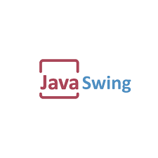
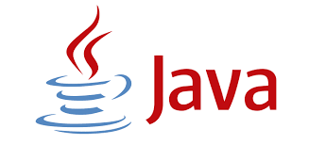


TECHNOLOGIES USED

Slide 6
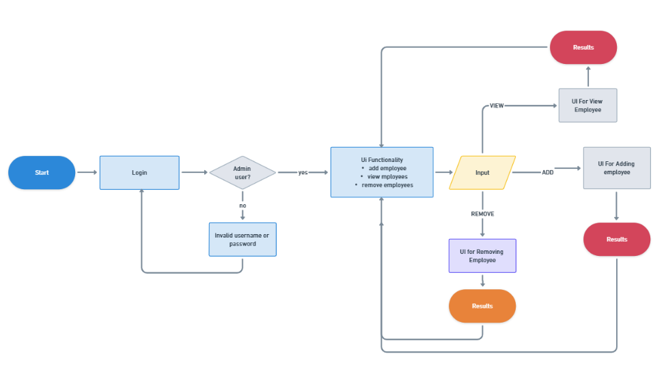
Flowchart

Slide 7
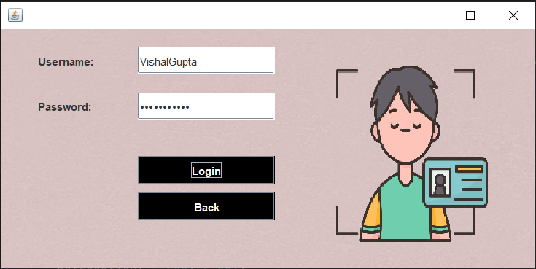
SYSTEM COMPONENT
Login Page: The login page serves as the entry point to the application, verifying user credentials and granting access only to the admins.

Slide 8
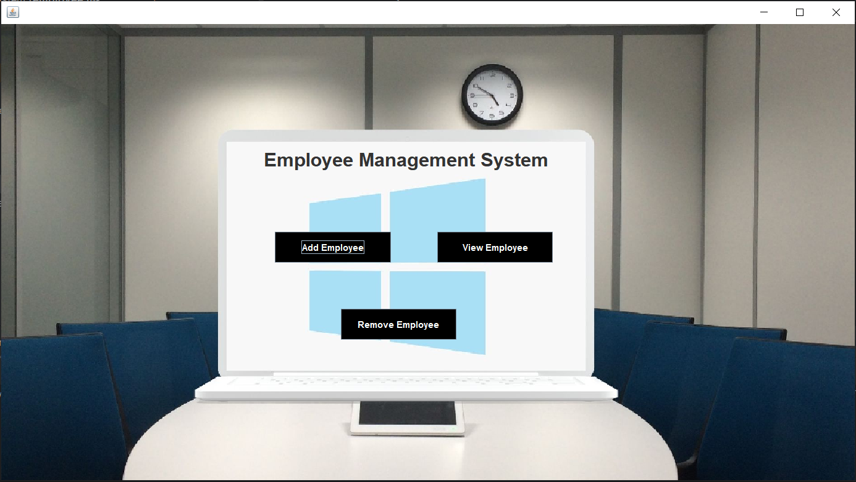
User Interface of application : The front page of the application offers an intuitive and user-friendly interface, enabling smooth interaction between the user and the system

Slide 9
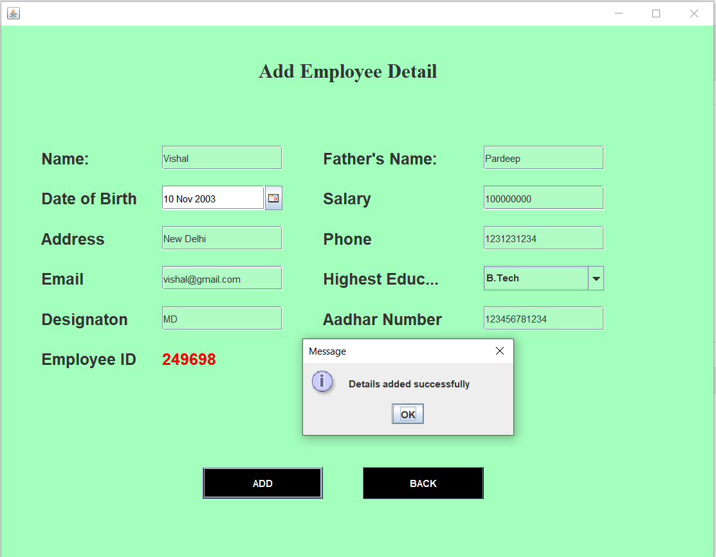
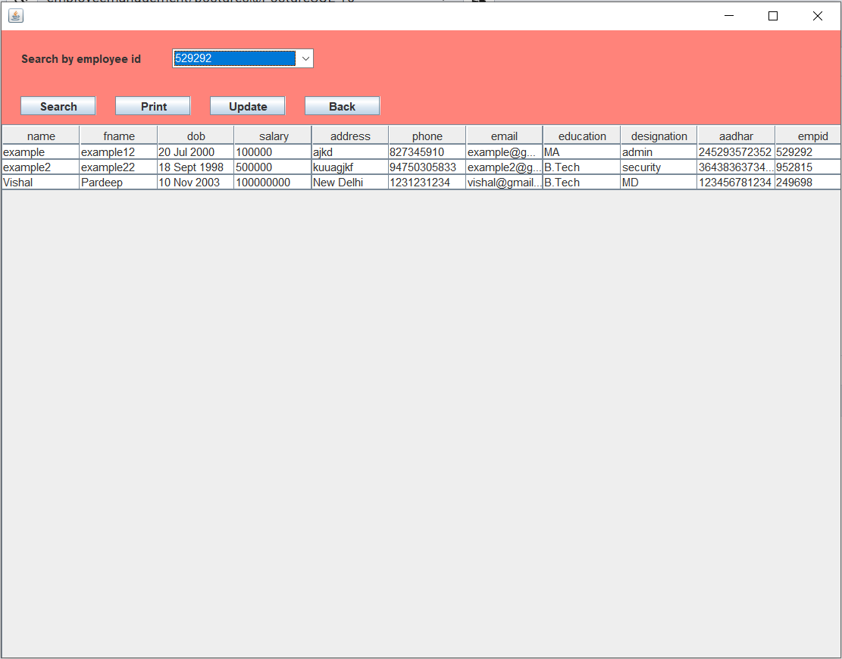
CRUD Operations Functionality: The system supports full CRUD (Create, Read, Update, Delete) operations, enabling administrators to efficiently manage employee data.

Slide 10
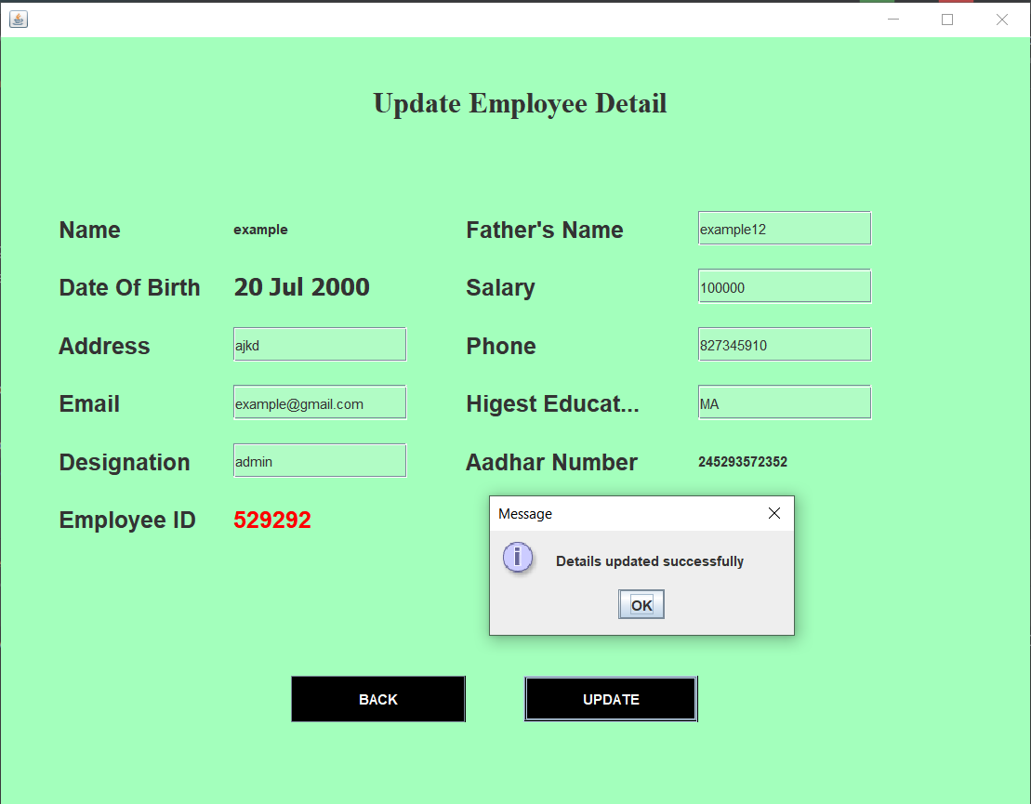
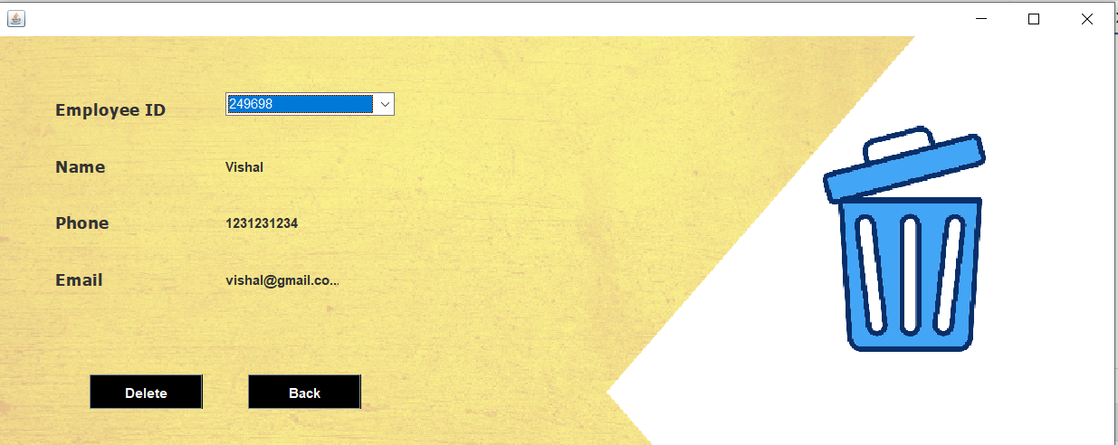

Slide 11
FUTURE SCOPE
Future enhancements for the Role-Based Employee Management System include:
1. Enhanced UI/UX: Add responsive design for mobile accessibility and allow users to customize themes and layouts.
2. Advanced Reporting: Integrate detailed analytics and custom report generation based on various parameters.
3. Mobile App: Develop a dedicated mobile app for convenient, on-the-go access.
4. Improved Security: Implement multi-factor authentication and data encryption to enhance security.

Slide 12
CONCLUSION
The Employee Management System is a robust solution for managing employee data and activities, ensuring secure and efficient operations within any organization. Built using Java, Java Swing, and PostgreSQL, the system allows only authorized personnel to manage and update employee information. With its user-friendly interface and comprehensive CRUD functionality, the system streamlines key HR processes, improves team management, and enhances organizational transparency. This scalable solution can be adapted to evolving business needs, making it a valuable tool for efficient employee management.

Slide 13
REFRENCES
GeeksforGeeks: Java Swing Tutorial. Retrieved from GeeksforGeeks Java Swing Tutorial
W3Schools: SQL Tutorial. Retrieved from W3Schools SQL Tutorial
Schildt, H. (2018). Java: The Complete Reference (11th ed.). McGraw-Hill Education.
PostgreSQL Documentation: Retrieved from PostgreSQL Official Documentation

Slide 14
THANK YOU!

